Slide 1
Unit 8 Climate Change
Key Concepts

Slide 2
Climate vs. Weather
What is weather?
Conditions of the atmosphere over a short period of time (e.g. day-to-day).
Includes current temperature, rainfall, snow, wind, floods, etc.
What is climate?
Patterns of the conditions of the atmosphere over long periods of time.
Summary of the average weather conditions expected in a given place.
Includes average precipitation, avg. seasonal temperatures, avg. humidity.
Notes:
Key factor here is TIME. Heat waves, random snow showers in May…these are extreme weather events – they are not considered the climate.

Slide 3
Climate Change
Changes in the AVERAGES (temperature, precipitation, etc.)
Not simply specific weather events.
Global warming contributes to climate change
Increase in the average global temperature
Leads to changes in weather
Leads to changes in long-term climate patterns
Notes:
Data shows that in the last 30 years we have not had the kinds of major snow storms that we used to. On average, our snowfall has decreased in our regain, suggesting a change in our overall climate. Just because you have one major event doesn’t mean the climate isn’t changing. Its all about AVERAGES

Slide 4
Greenhouse Effect (GHE): What is it?
GHE is a natural process
Carbon dioxide, methane, water vapor, and other gases trap heat energy and maintain earth’s temperature range.
Without the GHE we could not have life on Earth!

Slide 5
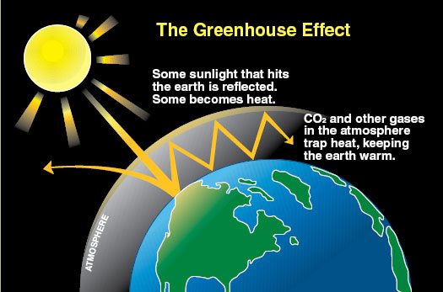

Slide 6
Greenhouse Effect (GHE): How do GH gases enter the atmosphere?
Carbon dioxide (CO₂) naturally enters the atmosphere through cellular respiration, wildfires, and volcanic eruptions.
CO₂ enters the atmosphere from human activity at MUCH HIGHER RATES:
Burning fossil fuels (gas, oil, coal)
For energy, heating homes, driving, etc.
By-product of industry and manufacturing – we make A LOT of stuff, and emit A LOT of CO₂

Slide 7
Greenhouse Effect (GHE): Linked to climate change
More CO₂ = more heat tramped in atmosphere
Increase in average global temperatures
Changes in weather patterns over time

Slide 8
Signs of Climate Change
Higher global temperatures
More droughts
Changing rain and snow patterns
More extreme weather
Higher ocean temperature and acidity
Rising sea levels
Melting glaciers
Shrinking sea ice
Less snowpack
Thawing permafrost
Your Projects!!

